Slide 1
Decision Making

Slide 2
Decision Making
Decision – choice among possibilities
  Assessment of available actions and determination of what actions to take

Slide 3
Decision Making
Sometimes it’s easy – what’s for lunch?
Sometimes it’s hard – what car to buy?

Slide 4
Theories
Normative (prescriptive models)
  Theories that tell us how we should decide or act
  Outline our rational choices
    (Question: are people really rational?)
  Used by economics and advertising

Slide 5
Theories
Descriptive models
  Theories that focus on how we actually make decisions
    These are a lot better!
  Usually study gambling (it’s easy and people like to do the studies)

Slide 6
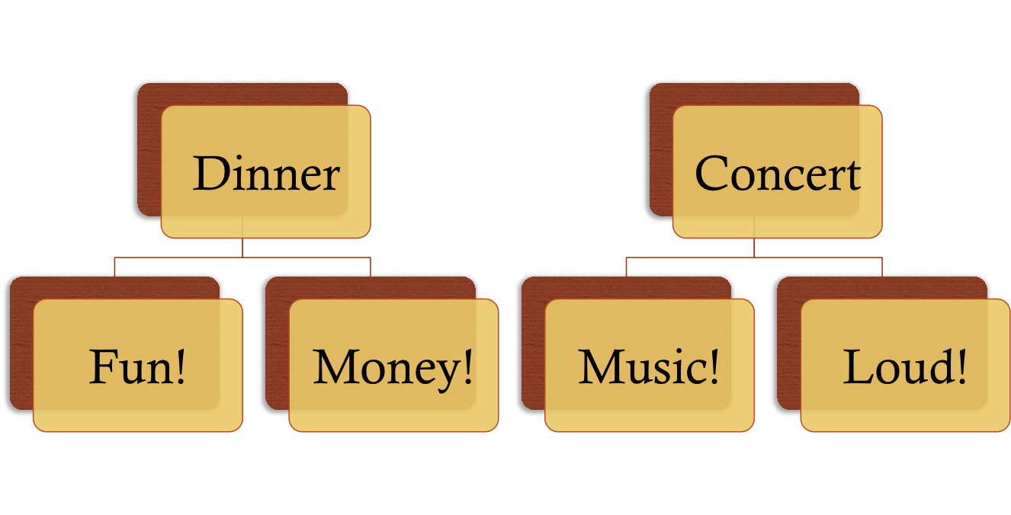
Decision Trees
Options under consideration, likely outcomes and consequences

Slide 7
Decision Trees
Alternatives – different choices, strategies available to decision maker and are braches of the tree
Beliefs – estimate of the likelihood of the outcome occurring if we select that option.
  Use these beliefs to assign probabilities to the different options

Slide 8
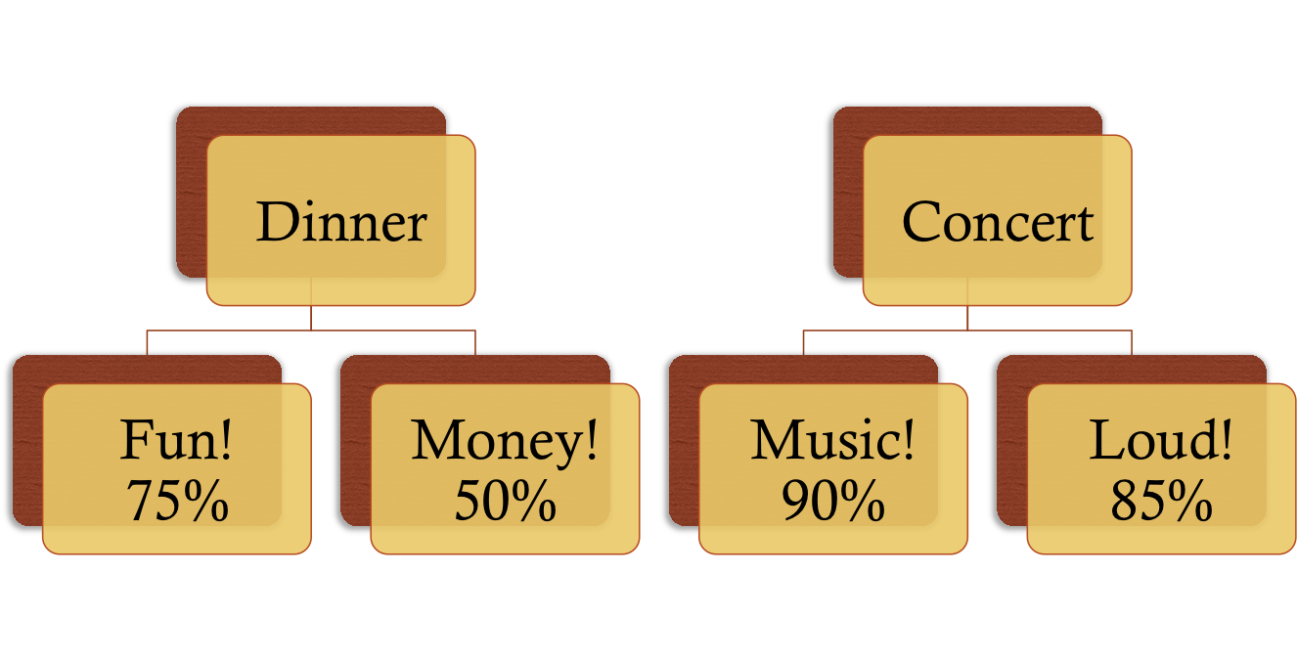
Decision Trees

Slide 9
Decision Trees
Consequences – benefits or losses you receive from a choice
  Outcome – result
  Value – net worth
  Utility – desirability of value to you.

Slide 10
Expected Utility Model
Assumes rational behavior in evaluating likelihood of alternatives
  Assessing consequences, assigning utilities, weighing utilities by likelihoods and choosing highest option
  Whew! All that = subjective utility

Slide 11
Expected Utility Model
How it works:
  Each choice X probability of outcome X utility
  Add’em up.
  Choose highest one.

Slide 12
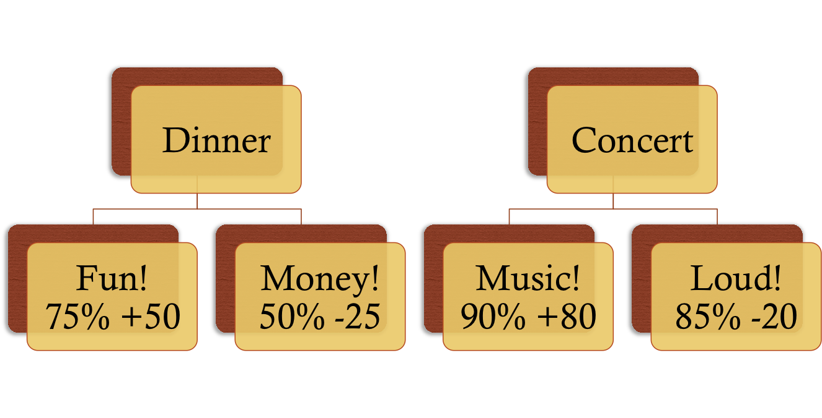
Decision Trees
.75X50 + .5X-25 = 25
.90X80 + .85X-20 = 55

Slide 13
Risk - Loss
Risk-averse people would prefer the certain gain of approximately $100, whereas others (the risk-seeking ones) would prefer the chance to win almost $200, even at the risk of getting virtually nothing.
Some people avoid a gamble with any potential loss outcome, no matter what the expected value and variance of the gamble are. People with this inclination, observed to a greater or lesser degree, are described as showing loss aversion.

Slide 14
Risk-loss
Losses mean more to us, we don’t like to lose things we have.
  In the simplest form of “riskless choice,” we tend to feel that the loss of utility in giving up something in our possession is greater than the gain of utility in obtaining that possession in the first place—that somehow the object acquires added value simply by belonging to us. This effect is known as the endowment effect.

Slide 15
Expected Utility Model
All that’s great. But people aren’t rational!
  Decision weights – estimates of likelihoods of outcomes.
    Overweight small probabilities (like winning the lottery)
    Ignore middle probabilities
    Overweight certain probabilities

Slide 16
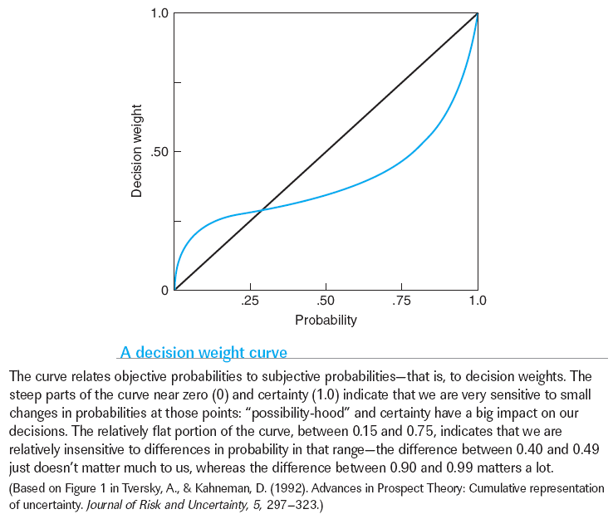
Chapter 9
Notes:
Comprehension Check:
1. Suppose that you bet $5 on red to come up on an American casino roulette wheel. If red comes up, you double your money (win $10), otherwise you lose your
$5. There are 18/38 chances of winning on red. What is the expected value of your $5 bet?
2. Now, consider the expected utility of your roulette bet on red: How is the expected utility different from the expected value? How could expected utility explain why people gamble on casino bets of this type?

Slide 17

Make Your Best Guess…
The FBI classifies crime in the US into to categories: violent crime (murder, rape, assault, robbery) and property crime (burglary, larceny, car theft)
  What percentage of crimes are “violent?”

Slide 18
Make Your Best Guess…
The FBI classifies crime in the US into to categories: violent crime (murder, rape, assault, robbery) and property crime (burglary, larceny, car theft)
  What percentage of accused felons plead insanity?

Slide 19
Make Your Best Guess…
The FBI classifies crime in the US into to categories: violent crime (murder, rape, assault, robbery) and property crime (burglary, larceny, car theft)
  What percentage are acquitted?

Slide 20
Make Your Best Guess…
The FBI classifies crime in the US into to categories: violent crime (murder, rape, assault, robbery) and property crime (burglary, larceny, car theft)
  What percentage of convictions are obtained by trial instead of plea bargaining?

Slide 21
…And the Envelope Please
What percentage of crimes are “violent?”
  12%
What percentage of accused felons plead insanity?
  <1%
What percentage are acquitted?
  <.25%
What percentage of convictions are obtained by trial instead of plea bargaining?
  <10%
Notes:
What percentage are acquitted?
<.25% of the 1% above

Slide 22
How well does the model work?
Two big issues:
  Transitivity – if A > B and B > C THEN A > C.
    But people don’t always stick to this rule.
    Choosing a lower bet with a higher pay off rate.

Slide 23
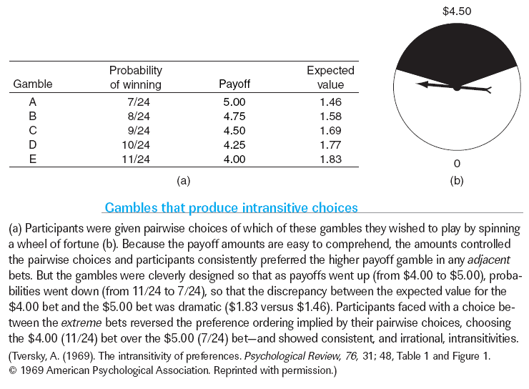
Transitivity
Chapter 9

Slide 24
How well does the model work?
Two big issues:
  Procedural invariance – two ways of asking same question should produce the same results.
    BAH!

Slide 25
Imagine that you are in charge of rescue efforts in the state of Texas. A big storm threatens offshore drilling rigs. If nothing is done, 300 people will surely die.
You have to decide which rescue plan to use.
If option 1 is enacted, 150 people will be saved.
If option 2 is enacted, there is a 50% chance everyone will be saved.
Notes:
Saving = gain
prefer option 1

Slide 26
Imagine that you are in charge of rescue efforts in the state of Texas. A big storm threatens offshore drilling rigs. If nothing is done, 300 people will surely die.
You have to decide which rescue plan to use.
If option 3 is enacted, 150 people will die.
If option 4 is enacted, there is a 50% chance everyone will die.
Notes:
Saving = gain
prefer option 1

Slide 27
How well does the model work?
This problem also called framing – way problem is worded makes a differences in our decision.

Slide 28
Framing
One theory that came out of framing:
  Prospect theory – our perspective (perception) of a situation is primary determinant of behavior
  Uses framing to make a reference point for behavior
    (current situation + gains + losses +…)

Slide 29
New Model!
Bounded Rationality
  The Nobel prize–winning psychologist and economist Herbert Simon proposed the idea of bounded rationality; that is, choice processes that are as rational as they can be, given cognitive limitations on the amount of information we can process.

Slide 30
Bounded Rationality
Satisficing – method that finds an option that is good enough to meet our desires.
  Provides a good outcome without a lot of mental effort.
  Takes too much brain to optimize.

Slide 31
Bounded Rationality
How do we satisfice? Two heuristics:
  Representativeness: Judgments of similarity to mental model
  Availability: Judgments of similarity to remembered examples
Notes:
Making general decisions based on specific information
Making specific decisions based on general information

Slide 32
How do we test all this stuff?
Iowa gambling task
  Uncertain decision making task
  4 card decks – goal is to earn money by selecting cards with gains/losses associated with each deck

Slide 33
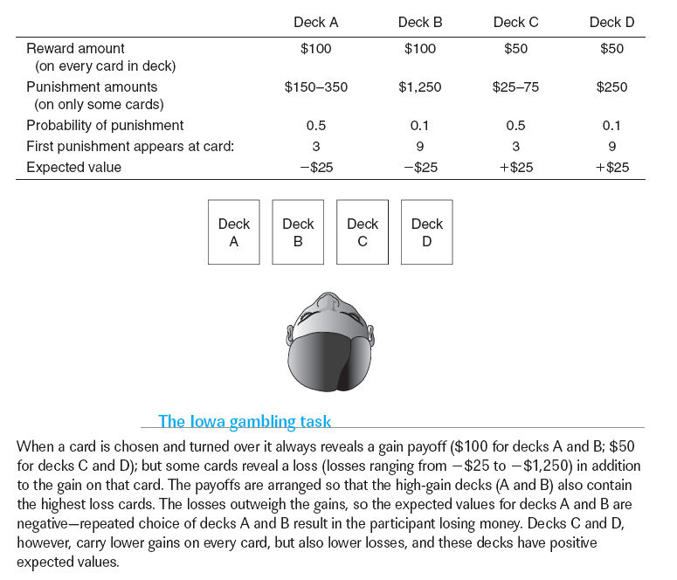
Complex, Uncertain Decision Making
Chapter 9

Slide 34
Iowa Gambling Task
So there are:
  Good decks – win money over time but low amounts
  Bad decks – lose money over time but big wins
People will start to go for large payoffs but then switch after a bunch of negative consequences

Slide 35
Iowa on the Brain
Normal Subjects
  Switch decks after playing for a while
  Show high galvanic skin response (GSR) to bad decks
Damaged Frontal Cortex
  Don’t switch decks
  No GSR to bad decks

